Slide 1

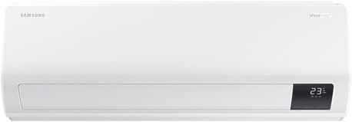
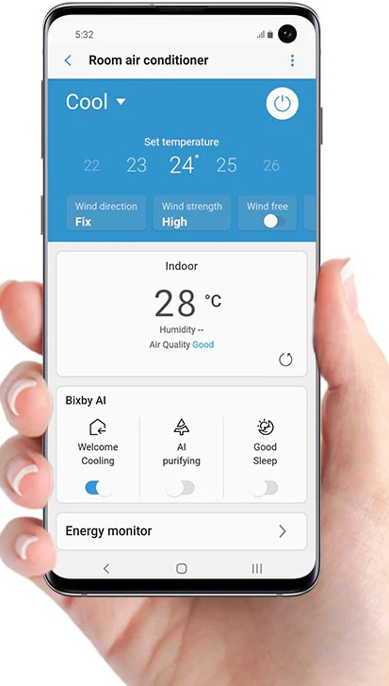
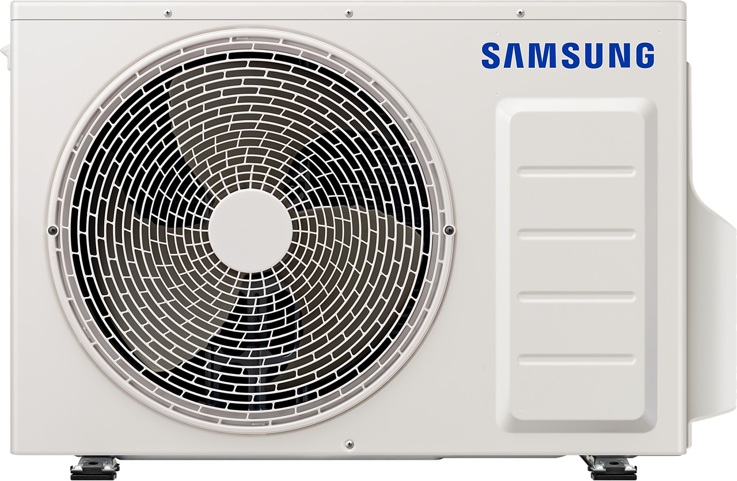
Samsung AI Smart AIRISE WindFree
Installation Included
Cooling: 7.1 kW
Heating: 8.0 kW
Built in WIFI
AI Function
Wind-free technology

